Slide 1



EMGT6225 TEAM PROJECT
Economic Analysis of Restaurant Business Establishment: A comparative study of property, equipment, and Raw material sourcing strategies
By-
Deep Bhattacharjee
Deveeka Ravi Meshram
Mufaddal Saifuddin Husain
Phani Sahithi Inturi
Raghav Luthra
Tushar Pralhad Pathak

Slide 2
Problem Statement
Comparative analysis of 12 restaurant scenarios in Boston: Property, equipment, and raw material procurement decisions over 10 years. Evaluating economic viability with FW, NPV, and payback period. Tailored insights for strategic decision-making
Deveeka Ravi Meshram

Slide 3
Why this topic?
This project topic was selected to delve into the intricate economic decision-making processes within Boston's restaurant industry, offering practical insights amidst uncertainty and risk. By focusing on real-world economic principles and addressing a literature gap, it aims to guide entrepreneurs through the complexities of establishing successful restaurants and contribute to applied economics research in a vibrant sector of Boston's economy
Deveeka Ravi Meshram

Slide 4
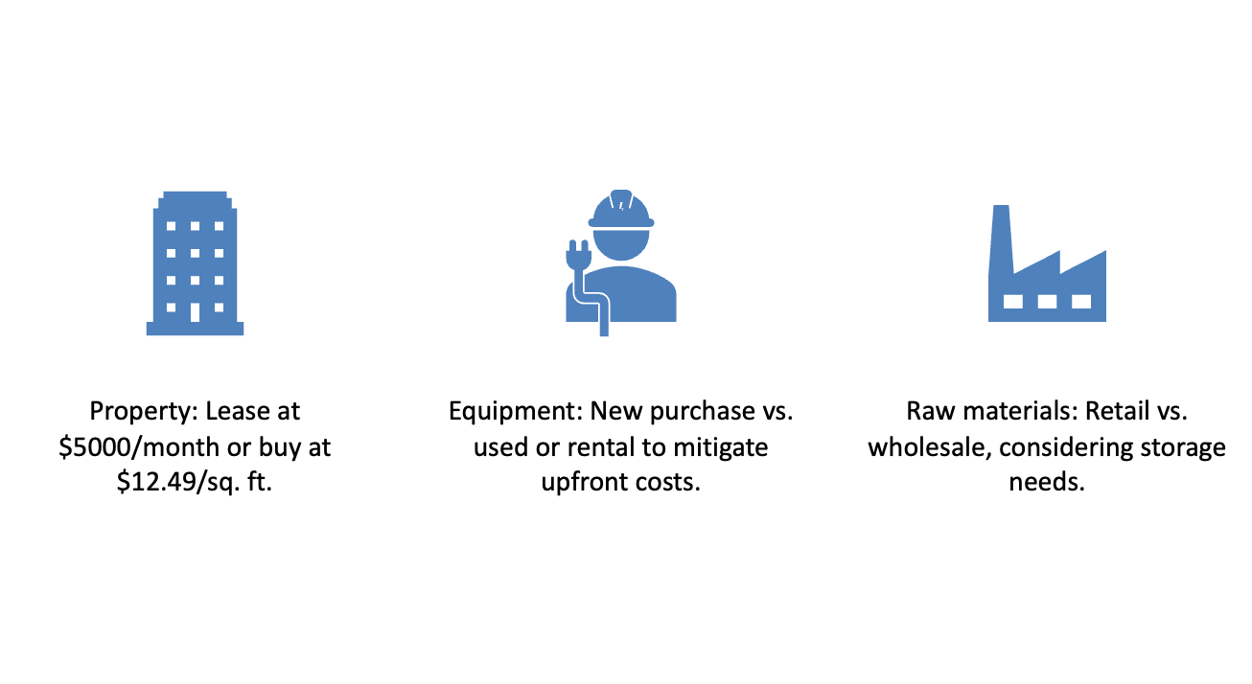
Alternatives considered
Raghav Luthra

Slide 5

Assumptions
Raw Material Sourcing Costs: Monthly costs of $4000 for retail and $3000 for wholesale sourcing, with a 5% annual increase to accommodate inflation.
Revenue Growth: Starting Monthly Income of $15000, with a 10% annual increase to reflect potential revenue growth over the ten-year timeline.
Initial Account Balance: Assumes an initial account balance of $25000 to cover operational expenses and ensure financial stability.
Equipment Operation and Maintenance (O&M) Costs: Assumed monthly O&M costs for new, used, and rental equipment, with respective values of $500, $750, and $700, each increasing by 10% annually.
Phani Sahithi Inturi

Slide 6



Deep Bhattacharjee
Factors considered
Raw Material:
Main sourcing directly impacts food quality and customer satisfaction
Choice between retail and wholesale sourcing to mitigate supply chain risks
Ensures quality ingredients without compromising on cost control
Property:
Determined based on physical environment factors
Layout and size of space directly impact operational efficiency and revenue generation
Options evaluated include leasing or buying property
Aligns with long-term business goals, financial ability, and growth plans
Critical for customer service and overall dining experience
Equipment:
Directly affects kitchen productivity and food quality
Influences operational cost and compliance with regulations
Right investment ensures smooth workflow and consistency
Choice between new, used, or rented equipment
Balances expense against durability, performance, and profitability
Crucial for maintaining operational efficiency and ensuring customer satisfaction

Slide 7


Data Analysis
Property:
Buying property yields greater future worth compared to renting.
Ownership of property provides control over the space and potential capital gains.
Leasing property lacks ownership benefits and equity accumulation over time.
Raw Material:
Purchasing raw materials wholesale offers bulk discounts and lower cost per unit.
Savings are achieved through wholesale purchases, compared to higher retail prices.
Retail purchases result in higher per-unit costs and pricing variability.
Equipment:
Buying new equipment and selling it after 10 years yields higher future worth.
Ownership of new equipment provides flexibility and operational control.
Used equipment entails higher maintenance costs and shorter lifespans, while renting lacks ownership benefits.
Mufaddal Saifuddin Husain

Slide 8
Data Analysis
Mufaddal Saifuddin Husain

Slide 9
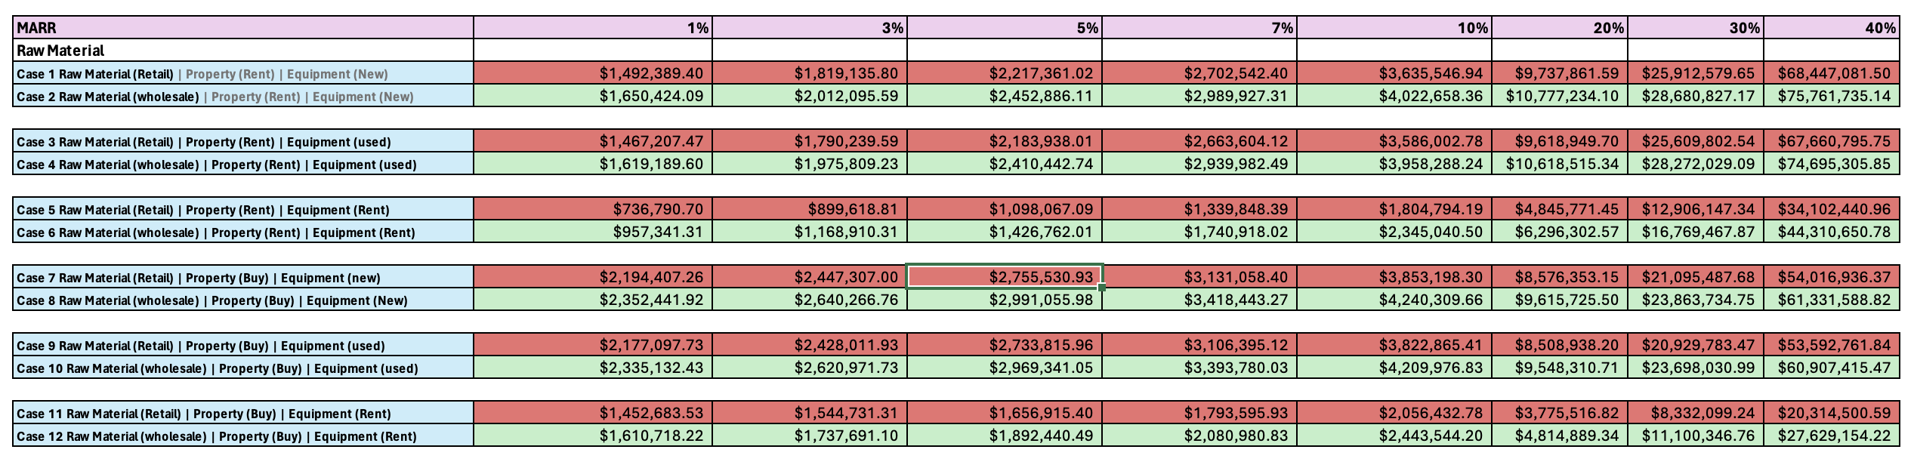
Data Analysis – Raw Materials
Procuring raw materials Wholesale is Recommended

Slide 10
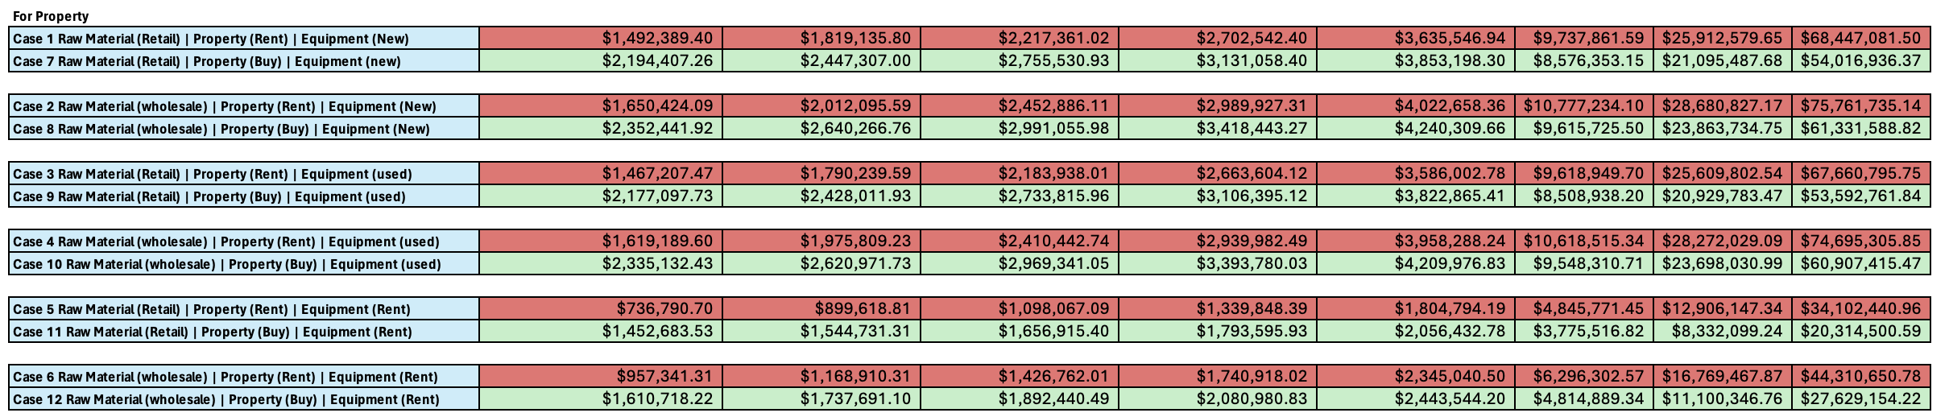
Data Analysis – Property
Buying a new property is Recommended

Slide 11
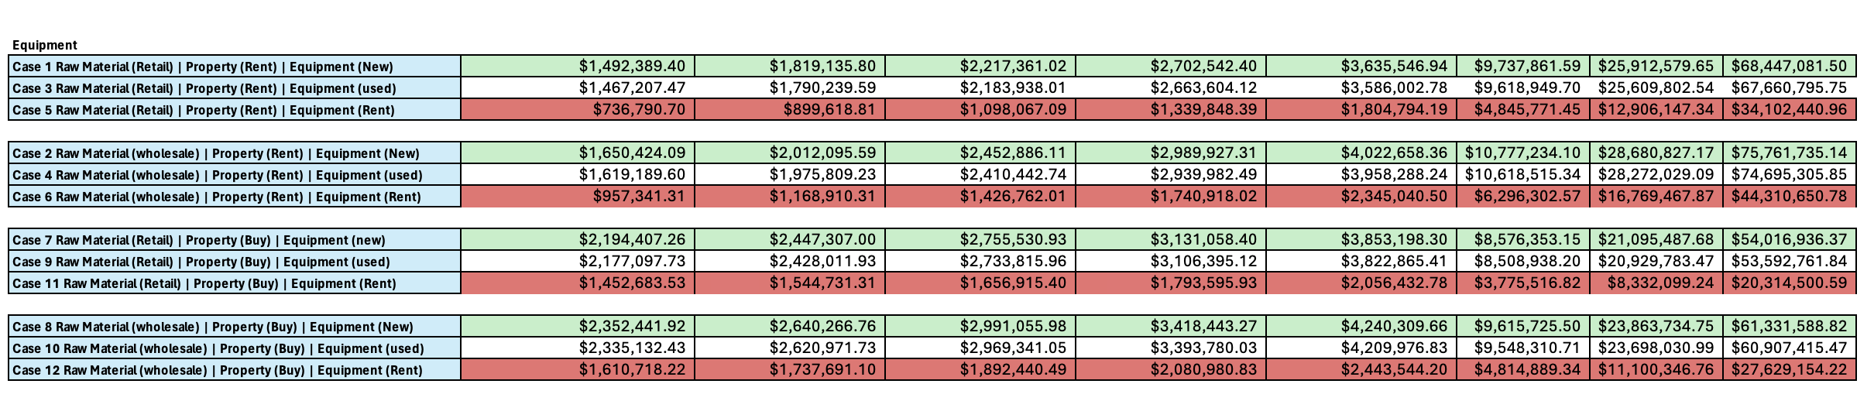
Data Analysis – Equipment
Buying New equipment is Recommended

Slide 12
Final Recommendation
Case 8 is Recommended: Rent property, acquire new equipment, and opt for wholesale raw material sourcing for optimal cost management and long-term profitability.
Case 5 Recommendation: Avoid due to high initial investment, escalating operational costs, and limited potential for profitability, making it an unattractive option for restaurant establishment.
Tushar Pralhad Pathak

